Slide 1
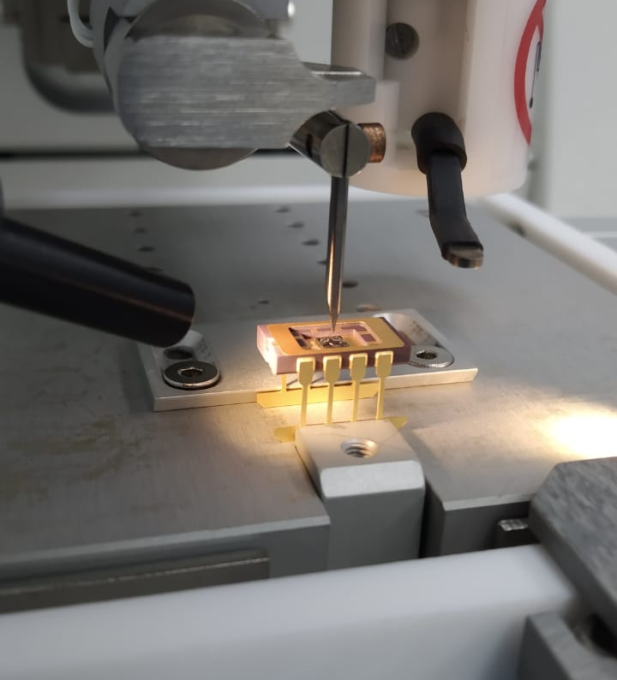
Gas Sensing Platforms: Technology, Products, and Applications
Multi Nano Sense Technologies
Enabling disruptive gas sensing solutions.
May 2026

Slide 2
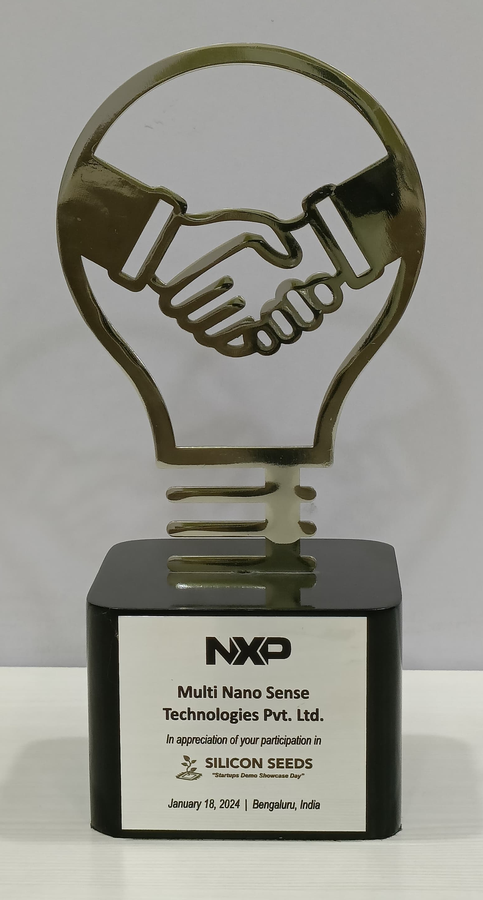
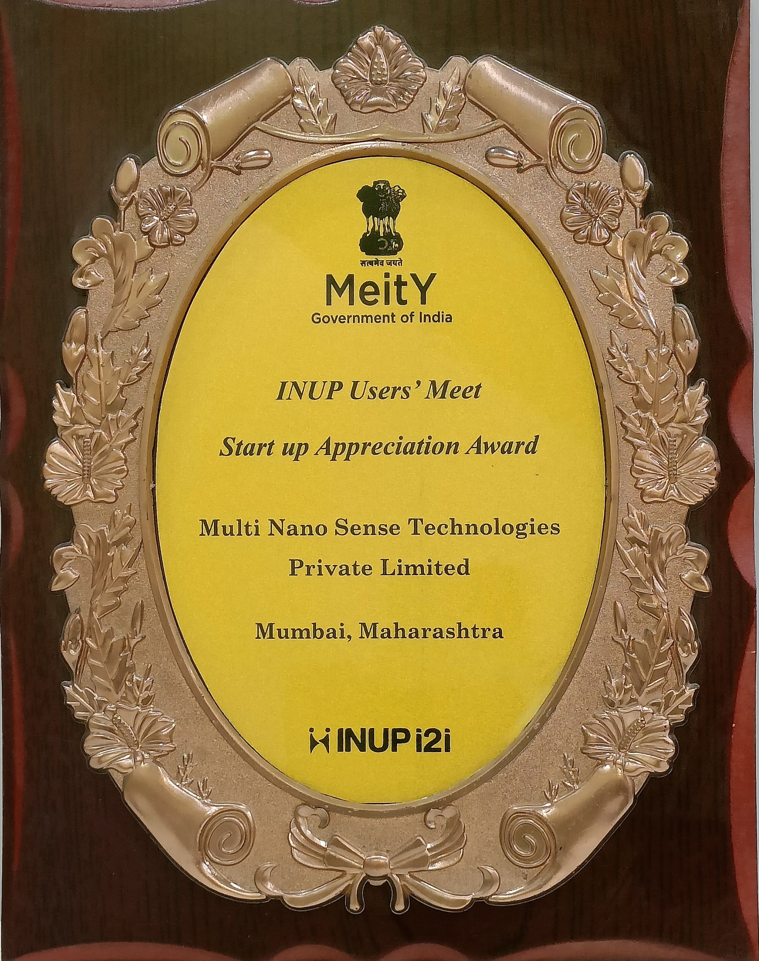
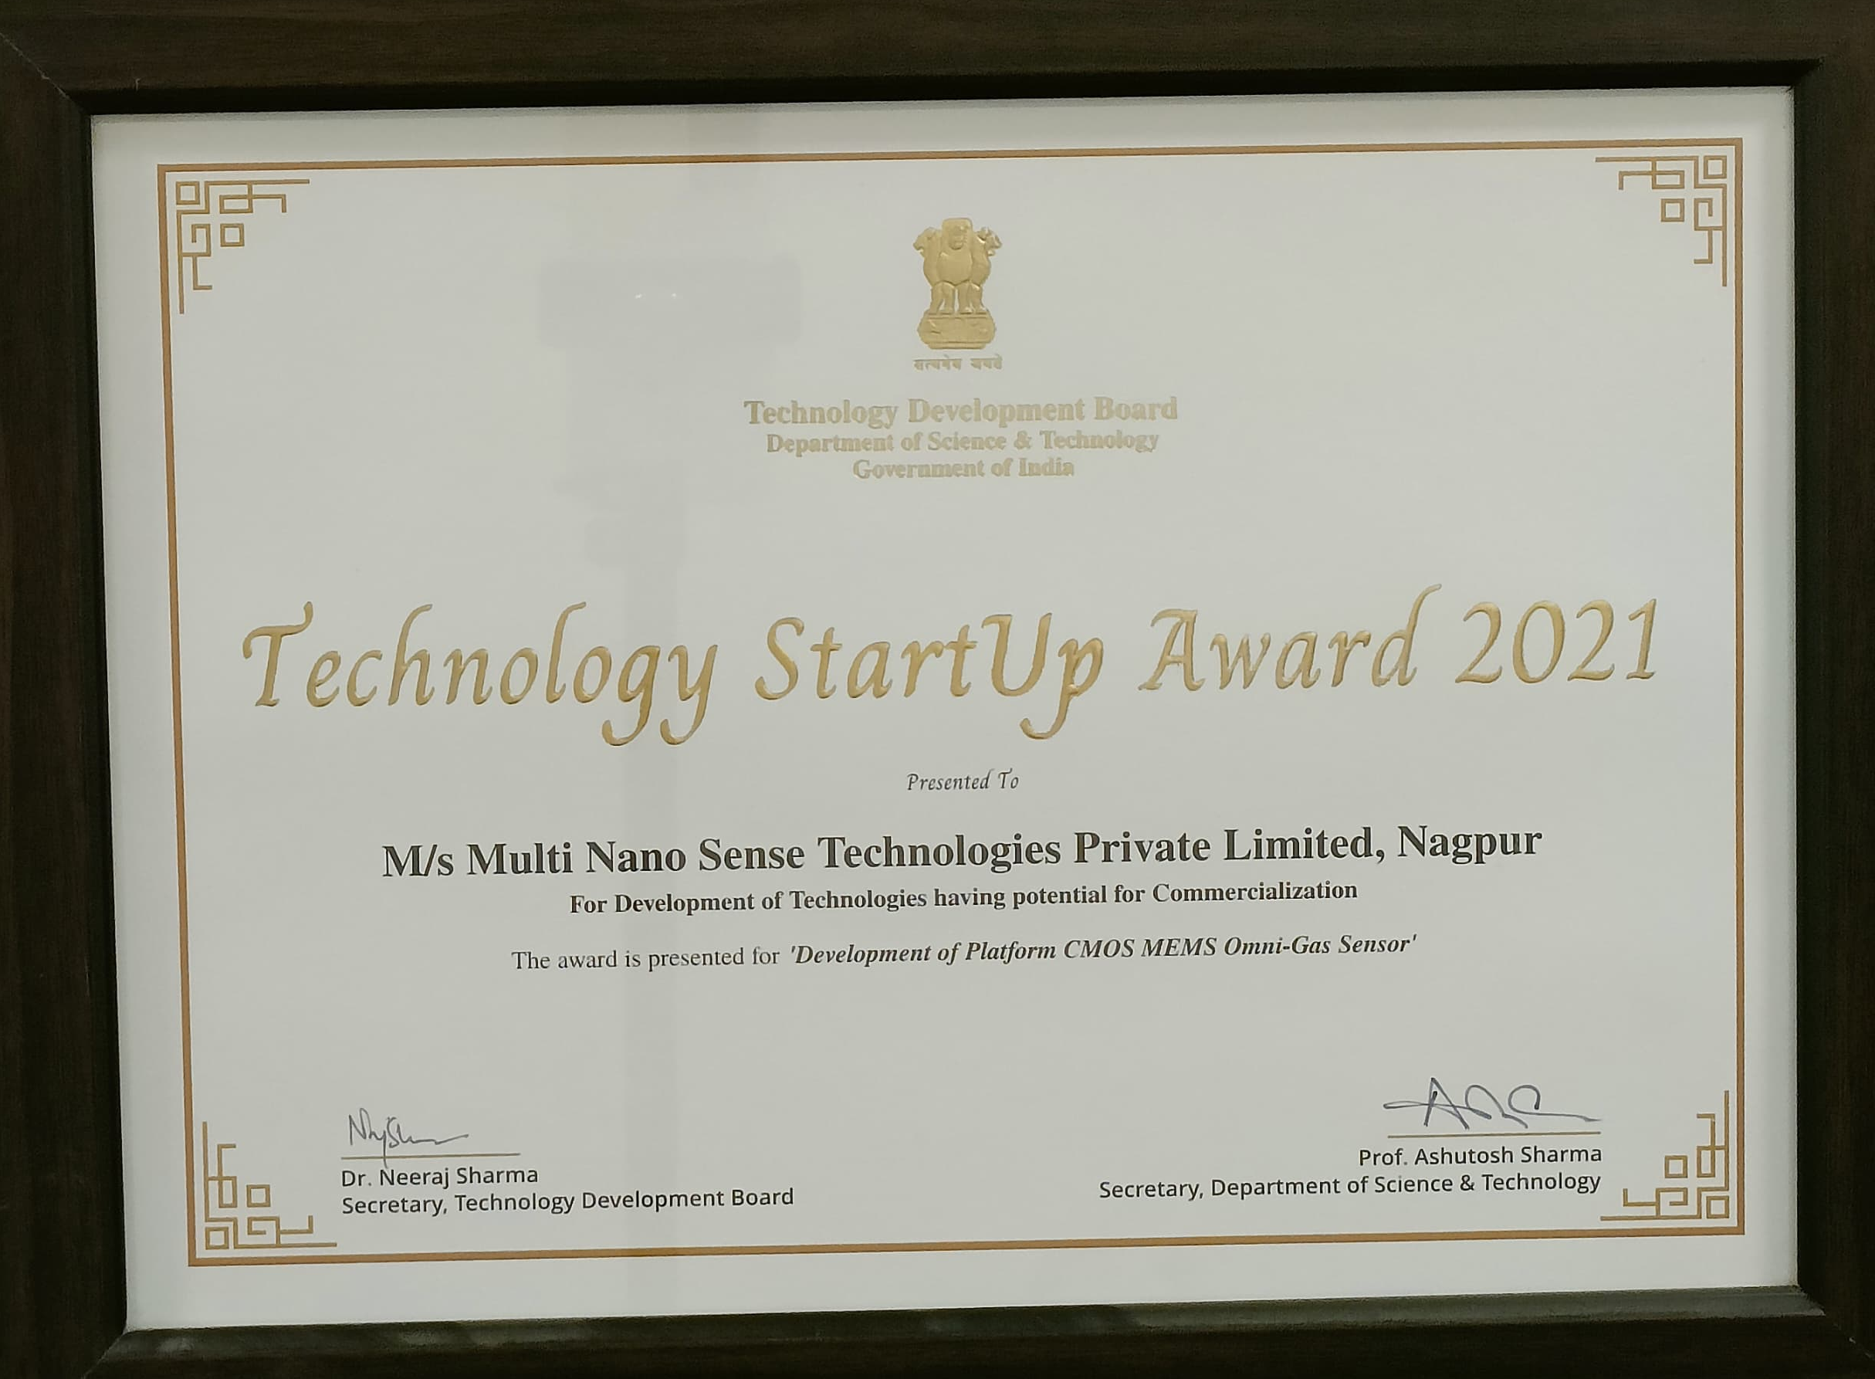
Company Overview
Multi Nano Sense develops and manufactures advanced gas sensing technologies, with patented hydrogen sensor products already deployed across industrial, energy, automotive, and safety applications
Fully indigenous hydrogen sensing platform, with the core sensor manufactured in India and supported through local engineering and production capabilities
Proprietary hydrogen sensing technology developed in India and protected through patent coverage; Indian Patent: 252998
The technology has progressed from early-stage research to field-deployed commercial products; traversed TRL 0 to 9
Hydrogen sensor products and gas detection systems are already in production and deployed across industrial, energy, automotive, and safety applications
Products available on Government E-Marketplace, enabling procurement by government, public-sector, and institutional customers
This commercial foundation provides a strong platform for the company’s next-generation MEMS gas sensing products

Slide 3
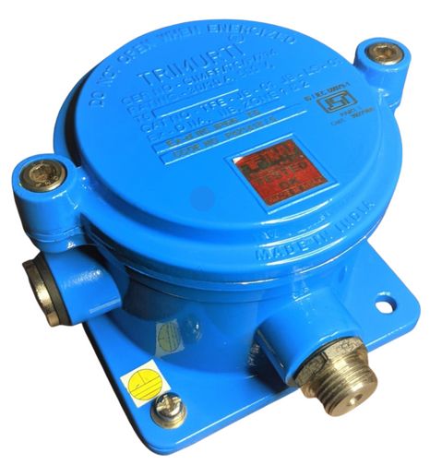
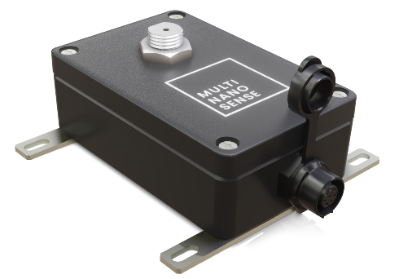
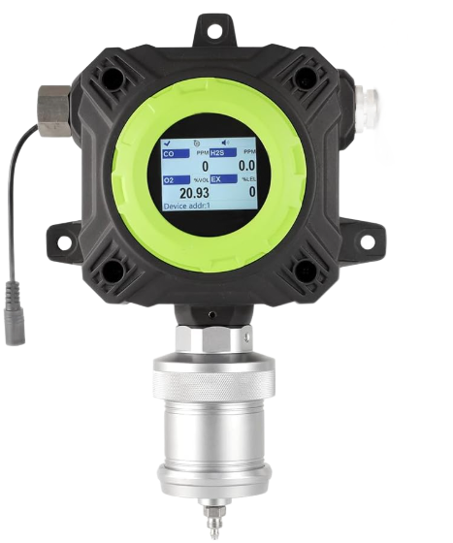
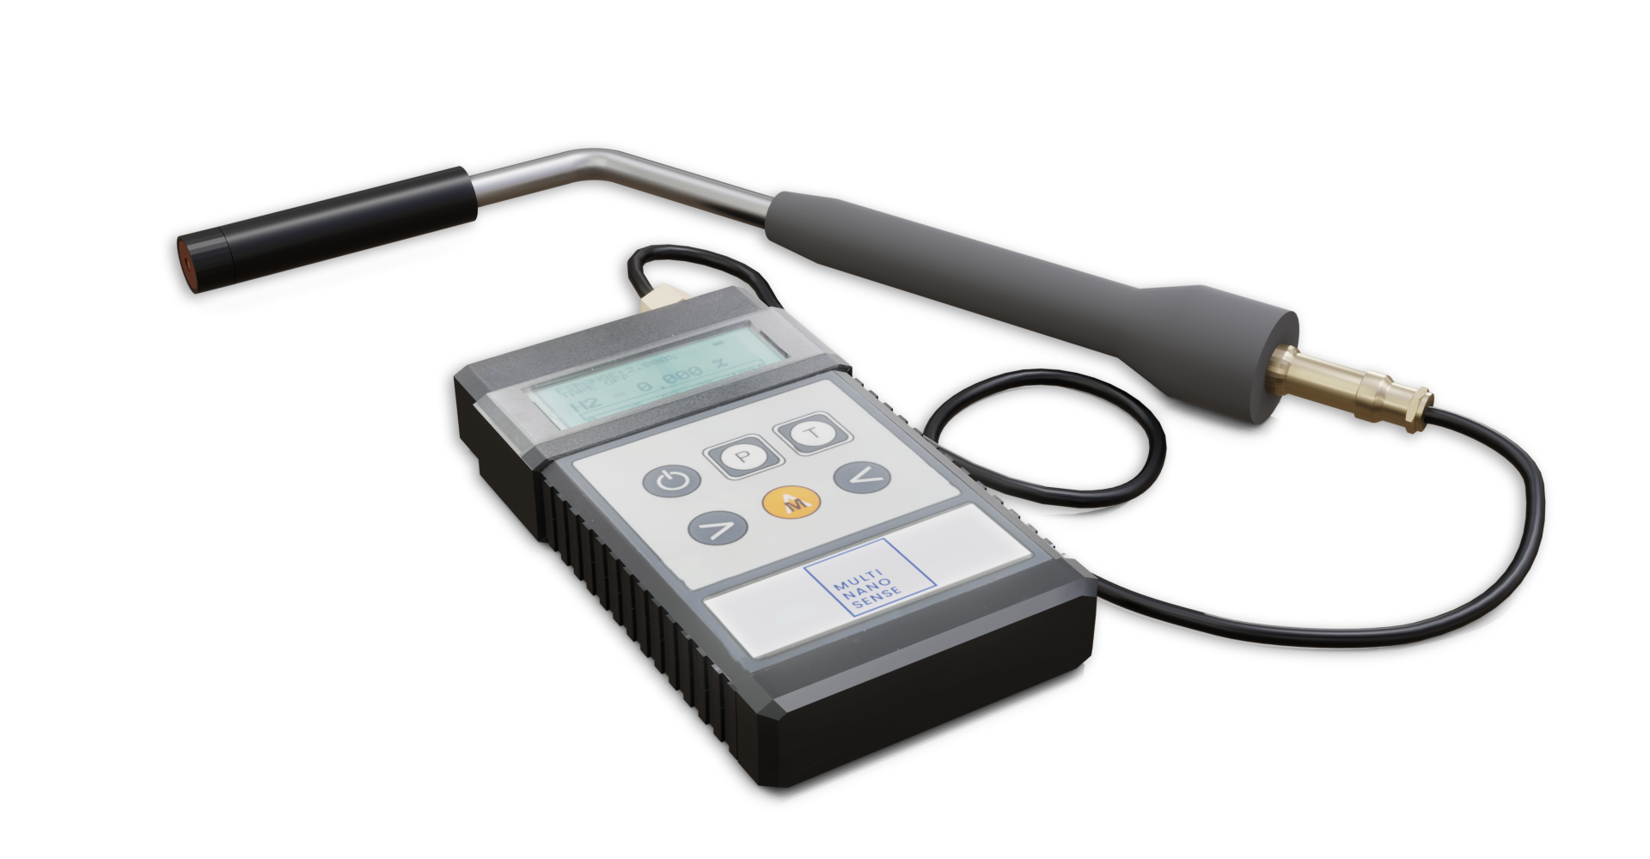

Existing Product Portfolio
Multi Nano Sense has converted its indigenous hydrogen sensing technology into a production-ready product portfolio for industrial, energy, automotive, and safety applications
Products in production include fixed hydrogen gas detectors, portable detectors, sensor modules, control and display units, and customized gas detection systems for customer-specific deployments.
Designed for regulated industrial and safety applications; Certifications: PESO (IS/IEC 60079-11 and IS/IEC 60079-0), ARAI (EMI/EMC), IP 68 (IS/IEC 60529). IECEx & ATEX in Process
Commercial adoption is validated by 65+ Indian customers and 45+ global customers across the USA, EU, and Australia

Slide 4

Technology Overview

Slide 5








SSEC Sensor Value Proposition
Applications
Highly Mature Sensor Platform
Field-proven solid-state electrochemical H₂ sensor
Technology matured from development to commercial deployment
Production-ready sensor platform
Fixed Leak Detection
Continuous hydrogen monitoring for enclosed industrial spaces
Suitable for permanent installation where early warning, low-level detection, and reliable field operation are required
High-Sensitivity Hydrogen Detection
Detection capability up to 1 ppm H₂
Suitable for early leak detection and low-level hydrogen monitoring
High-resolution single-gas measurement
High-Precision H₂ Analyzers for Mixed Gases
Accurate H₂ concentration measurement in mixed gases for process monitoring, R&D, calibration, and gas blending applications
Selective H₂ Measurement
Designed for hydrogen-specific detection
Zero cross-sensitivity to other gases
Reduces false alarms in mixed-gas environments
Unique Features
No External Excitation Required
Self-powered resembling a tiny battery
Generates its own measurable voltage signal without requiring any external power source or excitation circuitry
Portable H₂ Leak Detection
Handheld / portable detectors for inspection and maintenance in hazardous zones, hydrogen infrastructure, fuel-cell systems, and industrial facilities.
Proprietary Calibration Intelligence
Differentiated calibration algorithms
Improves measurement accuracy, repeatability, and long-term stability

Slide 6
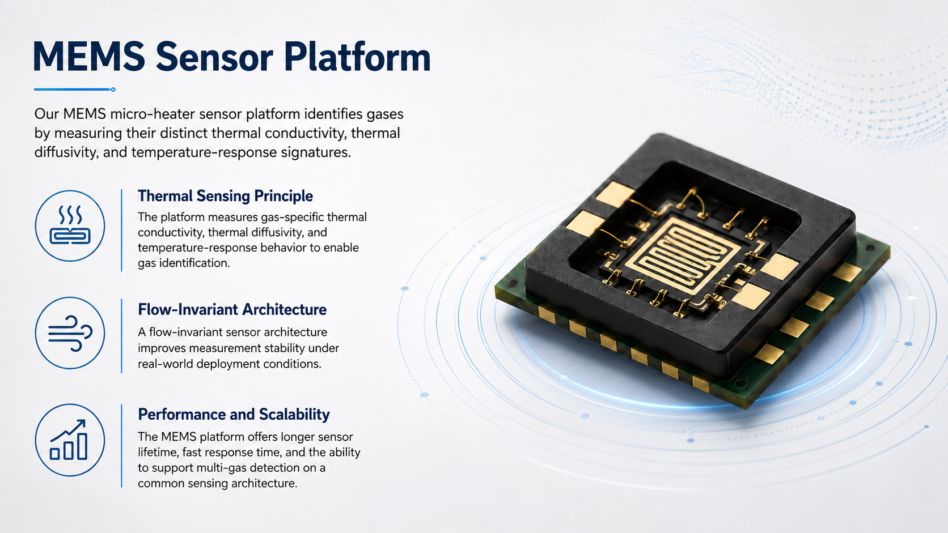
Technology Overview

Slide 7



MEMS Sensor Value Proposition
Unique Features
Applications
High Performance
Response Time < 200 mS
0% to 100% Operating Range.
10 Years Maintenance Free
High-resolution measurement capability.
Leak Detection
Hydrogen, Helium, Methane, SF₆, Hydrocarbons, Refrigerants and other Gases
Miniature, Low Power, Scalable
Compact MEMS structure with manufacturable sensor architecture
Analysis & Trends
Purity & Concentration Monitoring
Predicting Thermal Runaway
Transformer and equipment health check
Intelligent Processing
Measures gas-specific thermal conductivity, thermal diffusivity, and temperature-response signatures
Innovative sensor data processing algos
Joint Level Leak Detection
Pipelines, valves, flanges, connectors, cabinets, and sealed enclosures
Harsh Environment Operation
Designed for industrial temperature range, EMC robustness, and IP-rated enclosures
Hotspot Detection
Heat-flow sensing in conductors, cabinets, transformers, and thermal-risk zones

Slide 8
Challenges in Hydrogen Detection
Conventional gas sensing solutions are often bulky, power-hungry, and expensive to deploy across large installations
Poor reliability, especially in unmanned or harsh environments leading to frequent calibration, maintenance, or replacement
Existing solutions can’t scale where multiple sensing points are required across assets, facilities, or distributed infrastructure
High Cost, Size and Power
Functional Limitations
Not Scalable
Customers need gas sensing solutions that are compact, low-power, reliable, and scalable without compromising measurement accuracy.
As hydrogen, clean energy, industrial automation, and safety applications expand, sensing must move closer to the point of risk — across pipelines, joints, enclosures, equipment, and remote assets.
Hydrogen safety — leak detection across storage, distribution, and usage points
Industrial safety — continuous monitoring in hazardous environments
Energy infrastructure — distributed sensing across pipelines and joints
Smart monitoring — low-power sensors for remote deployments
Emissions and ESG — reliable gas detection for environmental needs
APPLICATION DRIVERS
The market needs gas sensors that are smaller, lower-power, more reliable, and scalable for dense field deployment

Slide 9
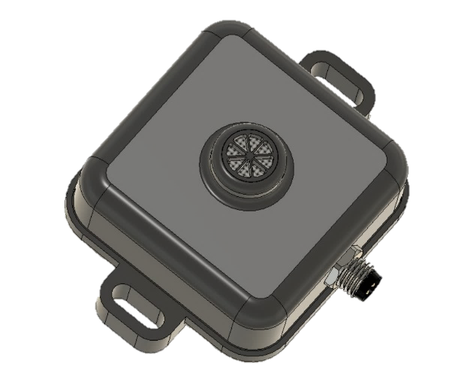
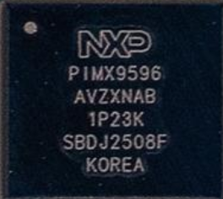
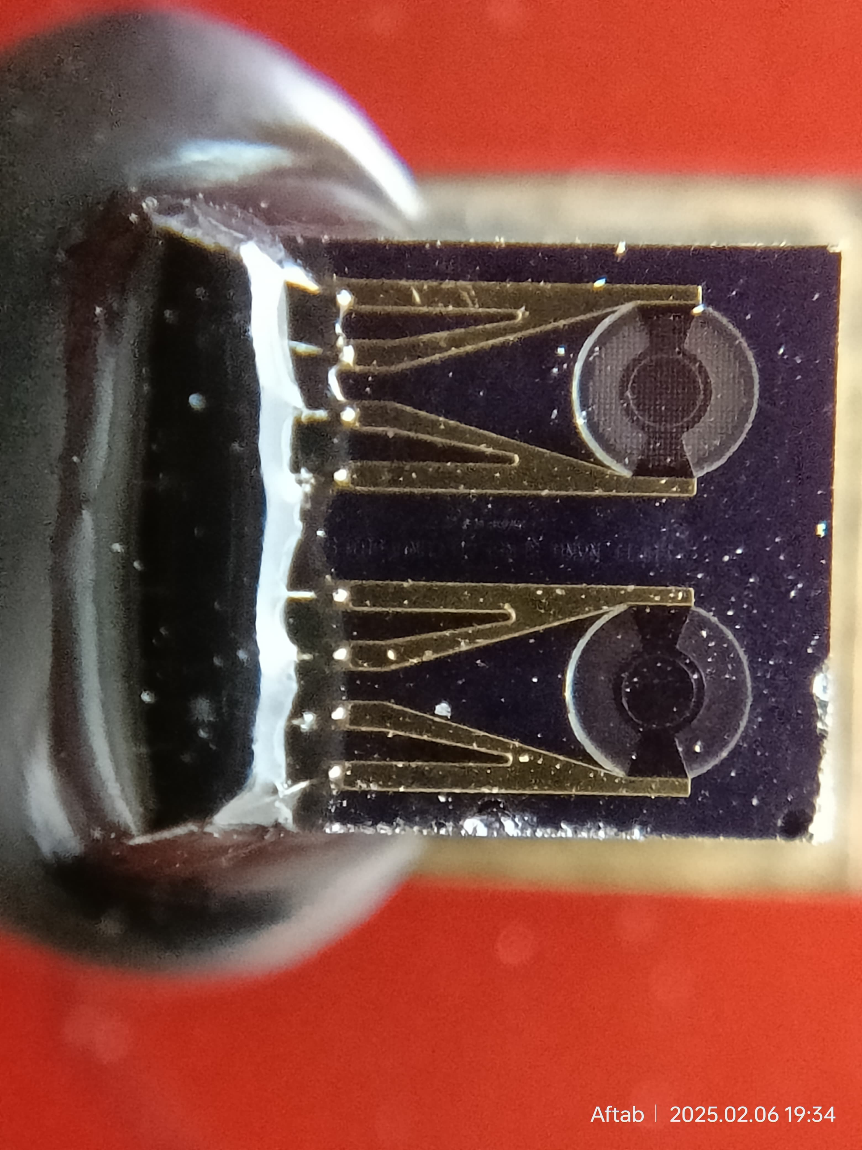





Product Concept Explainer – MEMS Sensor
MEMS Gas Sensor Chip
Gas Exposure Hole
Wired
CAN, RS485, 4-20mA
OR
Wireless
LoRa/ Wi-Fi/ NB-IoT
Source Current
MEMS Gas Sensor
MNST
AFE + Supporting Circuitry + Micro
2 Sensors per Die
External Power Module
24V to 3.3V & 1.8V
Sense Voltage
High Level Architecture Blocks
MEMS Gas Sensor
AFE + supporting circuitry
Power Module (on-PCB)
Wired or Wireless Comm (on-PCB)
Mounting Holes
Product Enclosure
(Top View)

Slide 10
Future Product Opportunities - MEMS Sensor Platform
The MEMS gas sensor platform can be extended into compact, low-power sensing products for distributed safety monitoring in homes, utilities, and hydrogen mobility applications
Home Gas Safety and Smart Metering
Automotive and Hydrogen Mobility
Smart Home Gas Leak Sensor integrated with alarm, shut-off, or app notification
Gas Meter-Connected Leak Detection Module mounted near or inside the meter assembly
Connected Gas Safety Node with wireless communication to app, gateway, or utility dashboard
H₂ Leak Sensor Module for Vehicles placed near tanks, valves, joints, fuel-cell stack, and enclosed compartments
Fuel-Cell Safety Monitoring Sensor connected to vehicle controller or safety ECU
Compact Automotive Sensor Package integrated into vehicle platforms without large sensor modules

Slide 11









Our Solution for Joint-level Leak Detection
Traditional Leak Detection
Our Approach – One joint One Sensor
Product Concept
Gas Leak Detector
Enclosure
MEMS
Flexible Ring
Joint
Miniaturized
Wireless
Battery Operated
Long Sensor Life
Withstands Pure Gas Exposure
Cross Section
Joints – Potential Leak Sources

Slide 12
Competitive Advantage
MEMS Gas Sensor offers several competitive advantages:
Parameter | Conventional Catalytic Sensor | Conventional TCD Sensor | Multi Nano Sense — CMOS MEMS TCD Sensor
Sensing Technology | Catalytic Pellistor | Thermal Conductivity | Flow Invariant Thermal Conductivity
Target Gas Capability | Typically one sensor for one gas | Limited multi-gas capability | One sensor platform for multiple gases including H₂, CH₆, SF₆ and other gases
Response Time | T90: 3 seconds T10: 10 seconds | T90: < 1 second T10: < 3 seconds | 2X-6X faster: T90 in <500 mS 5X-20X faster: T10 in <500mS
Form Factor | Larger module, around 148 cm³; 58 grams | Compact module, around 37 cm³; 15 grams | Compact MEMS solution: around 40 cm³; 25 grams
Power Consumption | Typically high, around 400 mW | Moderate, around 300 mW | Ultra-low power: around 30 mW, suitable for battery-operated products
Operating Range | 0.05 to 4 vol% H2 in Air | 0.4 to 10 vol% H2 in Air | We have the widest operating range: 0.01 to 100 vol% H2
Damage on Over-Exposure | Sensor gets saturated and permanently damaged. | No damage | No damage
Accuracy | At 1 vol%: ±0.1 vol% | At 1 vol%: ±0.4 vol% | 5X better: At 1 vol%: ±0.02 vol%
Customer Benefit | Suitable for basic combustible gas detection | Suitable for selected TCD applications | Faster, lower-power, more accurate, robust and scalable platform for industrial, safety and energy applications

Slide 13
Solutions Across Industries
The solutions are required across several industries
Power Gen and T&D
Oil & Gas and Petrochemicals
Hydrogen New Economy
Natural Gas Infrastructure
Energy Storage
Industrial Safety
We are bringing gas sensing to unimagined levels of miniaturization and affordability.
Examples:
1. Joint level leak detection is a market category creation – All hazardous, explosive, toxic gases – Verified need from Shell, Tata Motors, Cummins, Bosch
2. Smart Transformer Online DGA – A Rs 10,000 device compared to Rs. 30 lac system – TATA Power, L&T, State Discoms.
3. Inter-locked home PNG safety solution – A Rs. 1,500 device for 1.25 Crores houses - GAIL

Slide 14
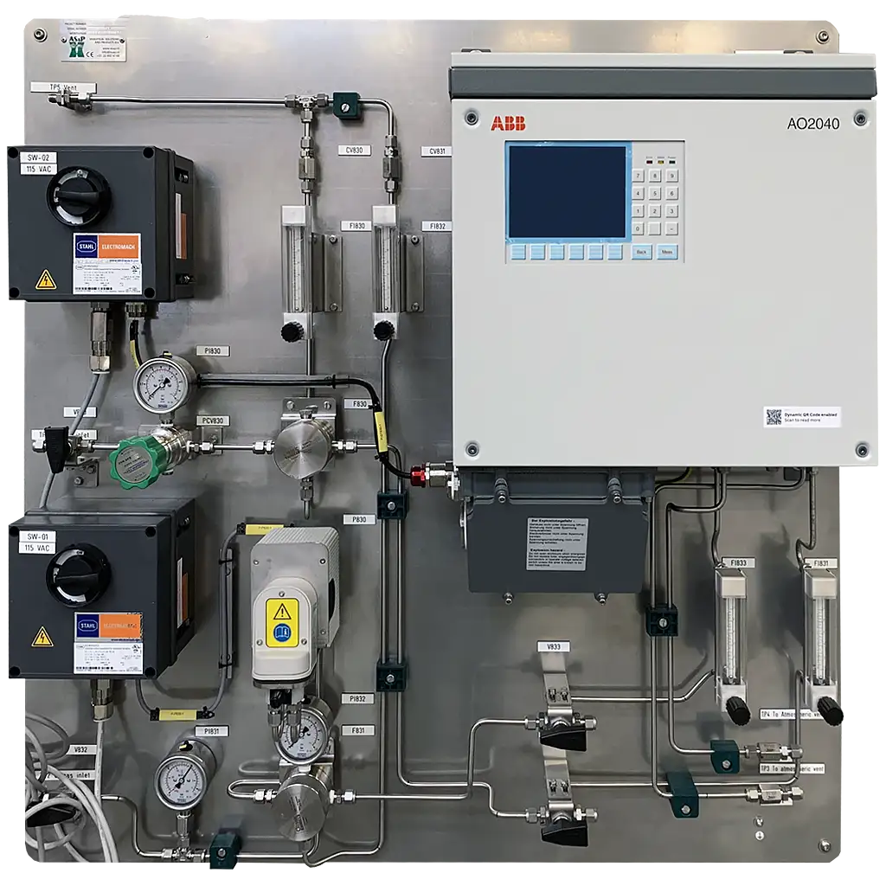
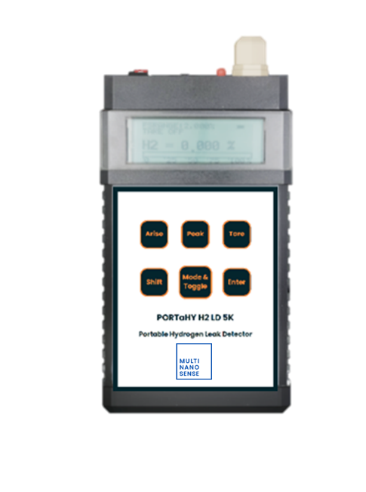
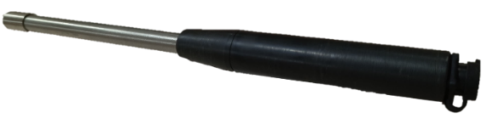
SSEC Sensor Product Portfolio
H₂ Analyzer
High-precision H₂ analyzer for continuous concentration measurement in process gas streams
Portable H₂ Leak Detector
Handheld portable H₂ leak detector for inspection and maintenance of pipelines, joints, valves, and equipment
Fixed H₂ Leak Detector
Wall-mounted or roof-mounted H₂ gas detector with audible / visual alarm for continuous area monitoring.
Self-calibration support
Humidity, temperature, and pressure compensation
Wired / wireless communication options
Applications
Oil & gas Steel manufacturing
Thermal power plants
Process industries using H₂ mixtures
Single-hand operation
Flush / compact probe design
Retractable probe for difficult-to-access points
Applications
Industries handling H₂ gas
Pipeline and joint inspection
Maintenance and commissioning
Hazardous-zone inspection
Continuous H₂ leak monitoring
Local alarm indication
Helps identify leak presence near risk zones
Applications
Automotive / H₂ mobility areas
Battery rooms and fuel-cell systems
Residential / utility gas safety
Industrial safety monitoring

Slide 15
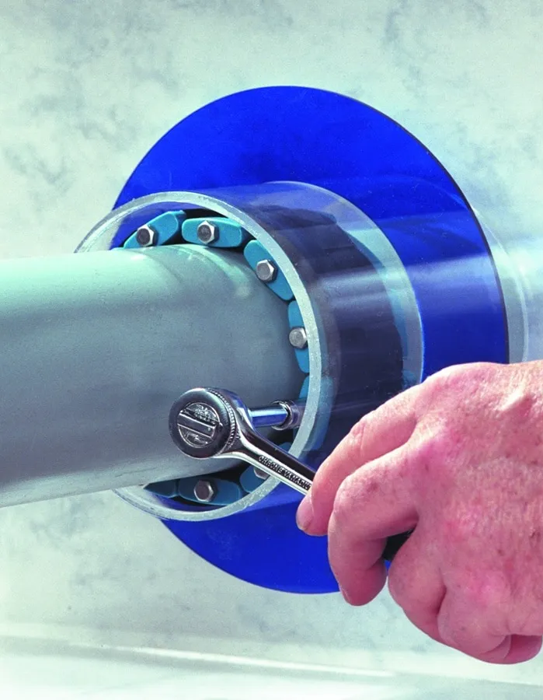
MEMS Sensor Product Portfolio
Fixed Leak Detector
Compact fixed gas leak detector designed for early leak detection with local alarm and wired / wireless connectivity options
Joint-Level Leak Detector
Circumferential leak detector designed to monitor gas leakage around pipeline joints, flanges, valves, connectors, and local boundary regions. Suitable for targeted monitoring at high-risk leak points
Continuous area monitoring
Compact and low-power MEMS sensing platform
Fast response for early leak warning
Applications
Oil & gas facilities Hydrogen storage areas
Automotive / H₂ mobility zones
Battery rooms and fuel-cell systems
Residential / utility gas safety
Detects leaks close to the source
Suitable for joint-level and flange-level monitoring
Reduces dependence on wide-area gas dispersion
Useful for distributed pipeline safety monitoring
Applications
Pipeline joints and flanges Industrial gas distributors
Plants with distributed pipeline networks
Hydrogen and fuel-gas infrastructure

Slide 16


















Our Customers – 100+ Global Base

Slide 17















Our Customers – 100+ Global Base

